Slide 1
C3G Flowchart
Author: ChiaLien,Hsu

Slide 2
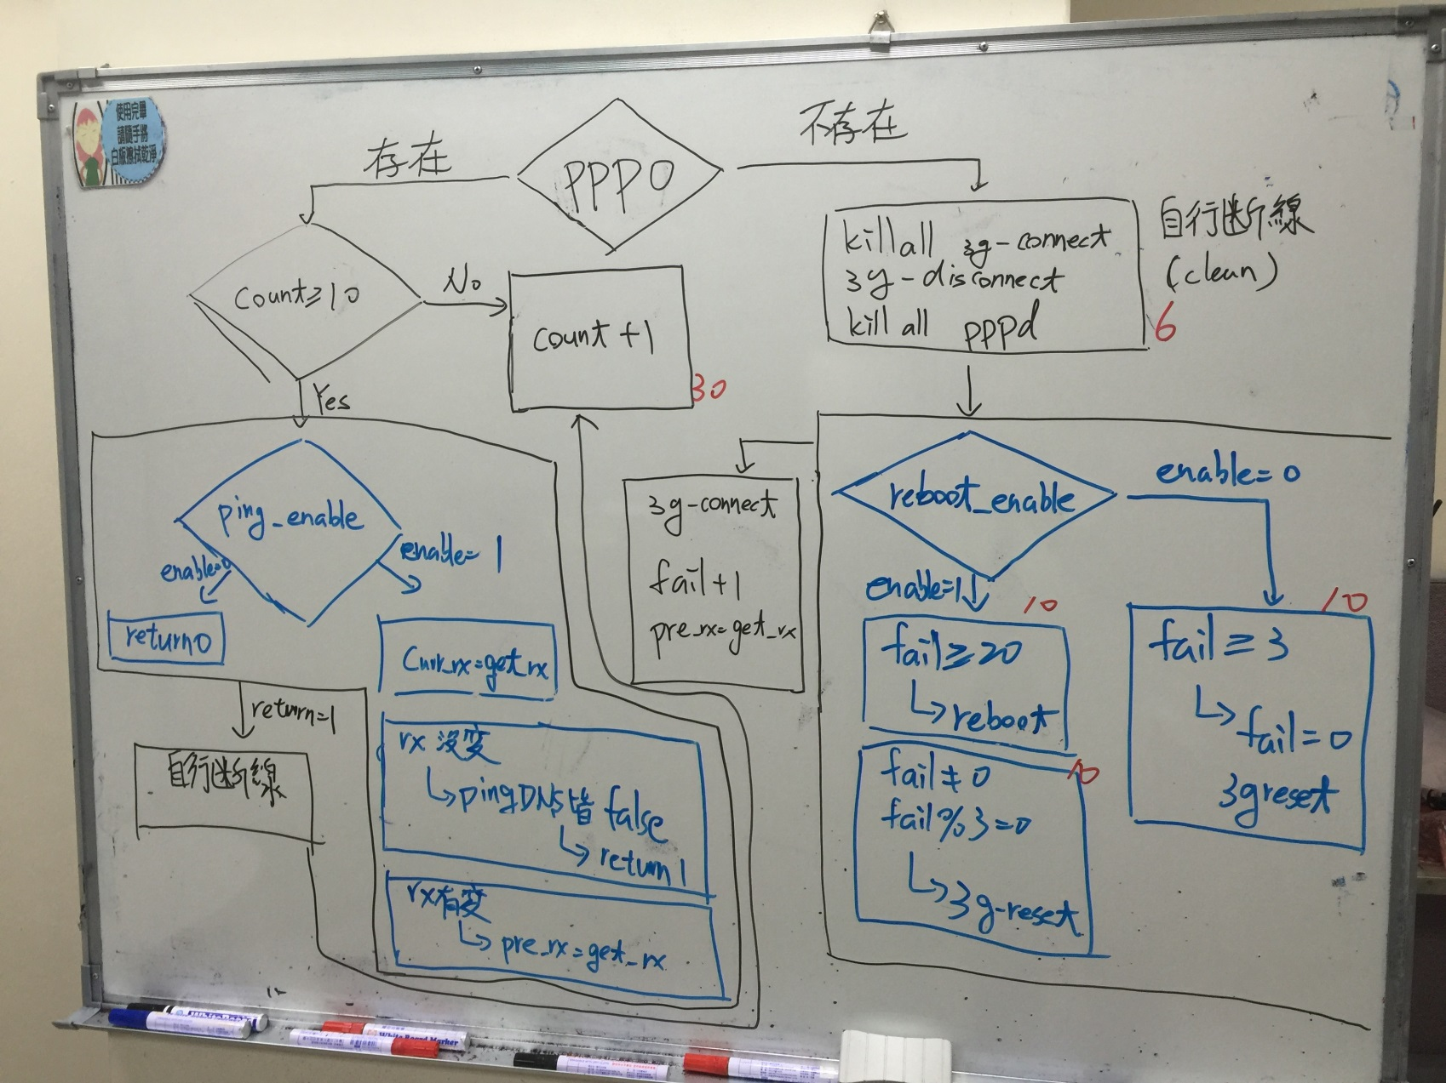
Manual Flowchart

Slide 3
FlowChart
PPP0 exist
PPP0
PPP0 missing
COUNT≧ 10
自行斷線(Clean)
NO
Yes
流量 Check
+
DNS Check
Return 1
自行斷線(Clean)
錯誤次數 Check
Return 0
連線
Fail + 1
Pre_rx=get_rx
Sleep 30
Count + 1

Slide 4
流量 Check + DNS Check
Enable=?
Enable = 0
Enable = 1
流量Check?
流量有變動
Pre Rx = Cur Rx
流量沒變動
DNS Check?
Check OK
Check NG
Return 1
Return 0

Slide 5
錯誤次數 Check
Enable=?
Enable = 1
Enable = 0
Fails ≧ 20
False
Ture
Fail ≧ 3
False
Fails ≠ 0 且3的倍數
Ture
False
Ture
Fail = 0
Reset Module
REBOOT
Reset Module
END

Slide 6
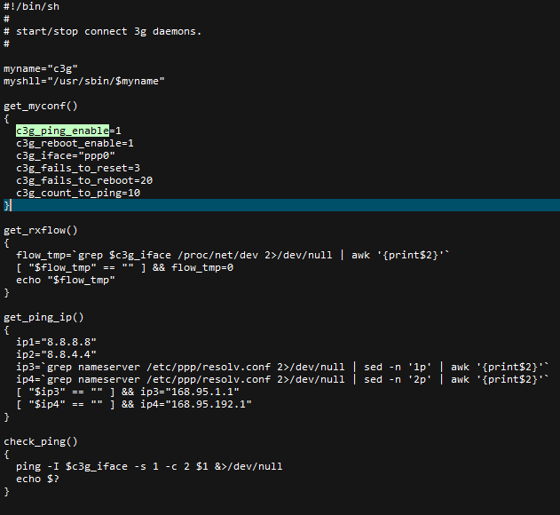
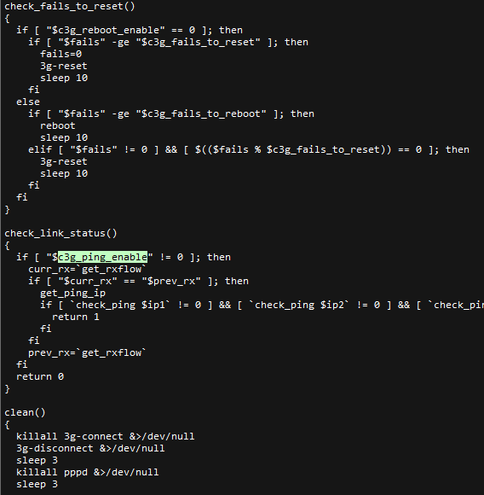
Code review

Slide 7
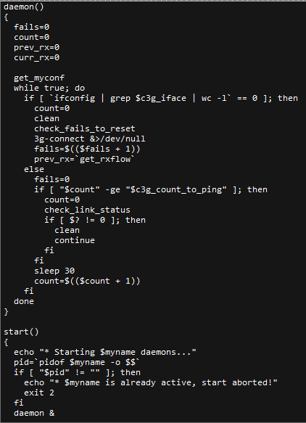
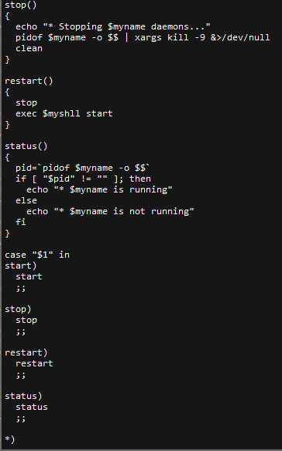

Code review

